Slide 1
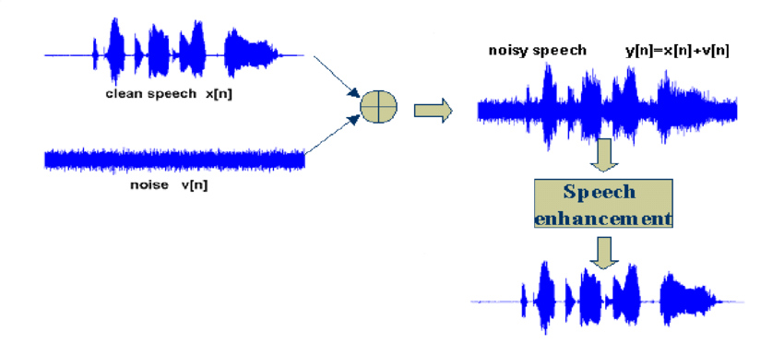

Slide 2
Training Model
Clean Signal
Noisy Signal
Compression
Quantization
FFT
Model Trained Result File (.h5)
ARN
Testing Model
Speech with noise
Function Trained Model File (.h5)
Clean Signal
Score evaluation
Model Evaluation STOI
PESQ

